Slide 1






Face Emotion and Age Detection
Student Details
Name:K.Mariya akash
NM Id:au513521105016
College Name:amcet

Slide 2
Disclaimer
The content is curated from online/offline resources and used for educational purpose only

Slide 3

Course Outline
Abstract
Problem Statement
Aims, Objective & Proposed System/Solution
System Deployment Approach
Model Development & Algorithm
Future Scope
Video of the Project
Conclusion
Reference

Slide 4


Abstract
A Real-Time Face Emotion Recognition and age detection System. Our project focuses on developing an advanced real-time emotional recognition system using state-of-the-art AI and ML techniques. Leveraging deep learning algorithms, the system aims to detect facial emotions and estimate age groups simultaneously. The goal is to revolutionize various industries by enhancing human-computer interaction and providing personalized user experiences.

Slide 5


Problem Statement
Facial emotion recognition in real-time is challenging due to human expression variability. Traditional methods struggle with accuracy, especially considering age as a factor.
Develop a system for face emotion and age detection that accurately identifies both the emotions and approximate age of individuals from facial images. This system should be robust, efficient, and capable of processing images in real-time or near real-time.

Slide 6

Aim and Objective
Aim: The primary objective of this Final Seminar is to present the outcomes and advancements made in the project “A Real-Time Face Emotion Recognition and age detection System.” “

Slide 7
Objectives
Emotion Detection: Train a deep learning model using a diverse dataset to accurately recognize a range of emotions, including happiness, sadness, anger, surprise, etc.
Age Estimation Model: Develop an age estimation model utilizing facial features, wrinkles, and other age-related cues to categorize individuals into specific age ranges.
Real-time Processing Optimization: Optimize the solution for real-time processing, minimizing latency while maintaining high accuracy in emotion and age detection.
Robustness to Variability: Enhance the system's robustness to variations in lighting conditions, image quality, and camera angles.
User Interface Integration: Develop a user-friendly interface for seamless interaction with the system.
Scalability and Adaptability: Design the system to be scalable and adaptable to different hardware configurations for broader applicability.

Slide 8

Proposed Solution
Solution: The project involves utilization of Convolutional Neural Networks (CNNs) for facial emotion age recognition.
Integration of pre-trained age detection models based on CNN architectures.
Implementation of efficient data preprocessing techniques for enhanced performance.
Deployment of optimized model architectures for real-time processing on resource-constrained devices.
Notes:
8

Slide 9
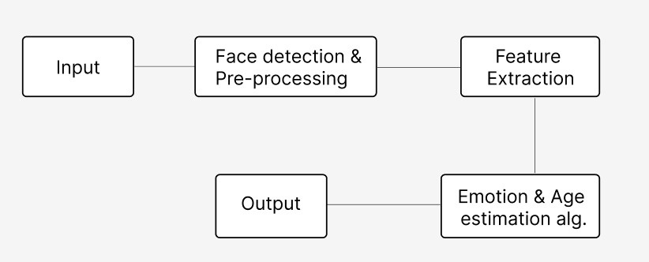
System Deployment Approach
Notes:
9

Slide 10
Model Development & Algorithm
Dataset Description:
The dataset contains digital face images.
Size of dataset is 1800
Categorized into five classes
Anger, Happy, Neutral, Sad, Surprise
Each classes has around 350 images
Notes:
10

Slide 11
Model Development & Algorithm
Image Preprocessing:
We have used CV2 for digital image processing.
The preprocessing is done in 2 steps,
Grayscalying,
Resizing
Grayscaling is done using cv2.IMREAD_GRAYSCALE function.
Resizing the image to a (256,256) size using cv2.resize(img, function.(256, 256))
Notes:
11

Slide 12
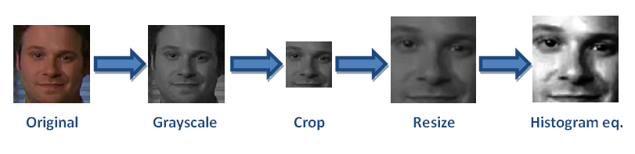
Model Development & Algorithm
Pre-processed Image:
Notes:
12

Slide 13
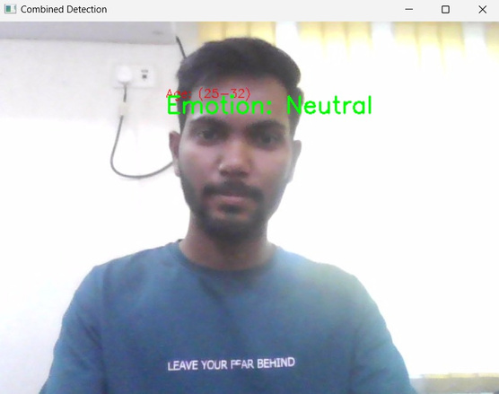
Result
Notes:
13

Slide 14

Future Scope
Emotion monitoring: Assist in monitoring patients' emotional states, particularly for mental health disorders like depression and anxiety.
Therapeutic applications: Use in therapy sessions to track emotional responses and progress.
Security: Age detection for access control and emotion detection for threat assessment.
Customer Service: Improving support by understanding users' emotions during interactions.
Notes:
14

Slide 15
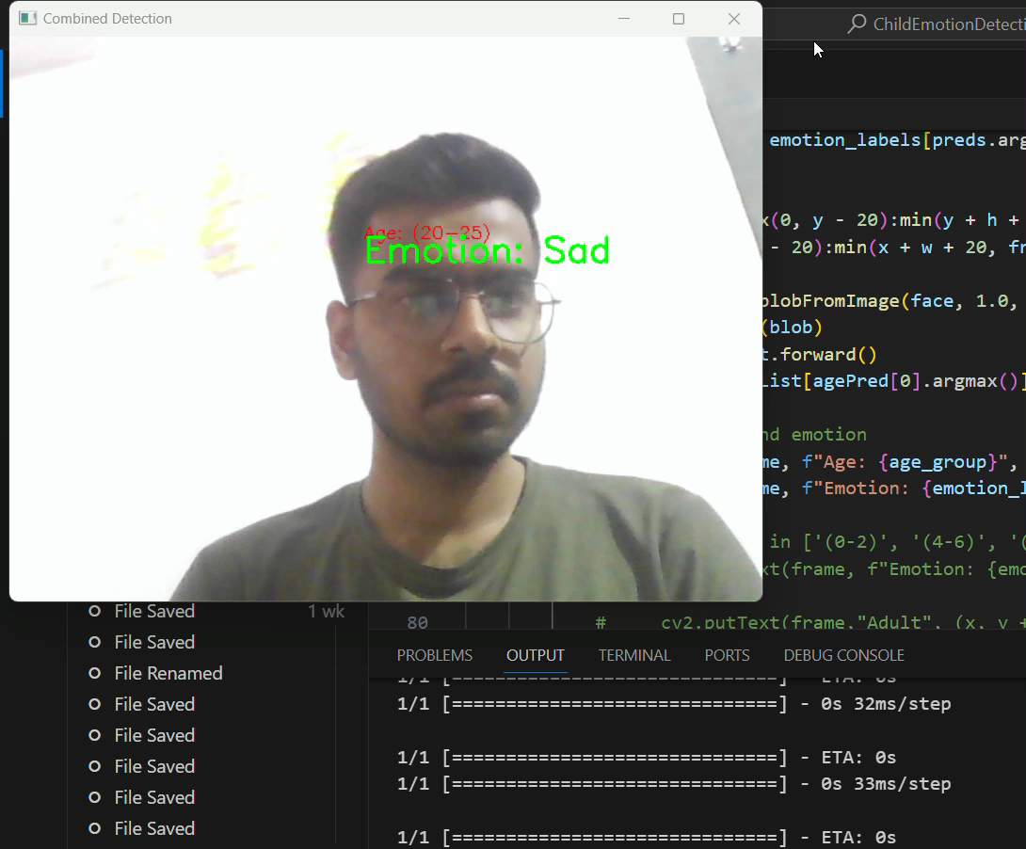
Video of the Project
Notes:
15

Slide 16

Conclusion
Our project represents a significant advancement in real-time emotional recognition.
By considering both facial emotions and age, the system enhances human-computer interaction.
Leveraging cutting-edge AI/ML techniques and innovative system design, our goal is to create a versatile and efficient system for personalized user experiences across various domains and applications
Notes:
16

Slide 17
Reference
https://www.researchgate.net/publication/339347740_Facial_emotion_recognition_using_convolutional_neural_networks_FERC
https://ieeexplore.ieee.org/document/9825223
http://cs231n.stanford.edu/reports/2016/pdfs/005_Report.pdf
https://papers.ssrn.com/sol3/papers.cfm?abstract_id=3833759
https://ieeexplore.ieee.org/document/8673352
Notes:
Reference
These are the references for this session.

Slide 18
Thank you!
Notes:
18

